Slide 1
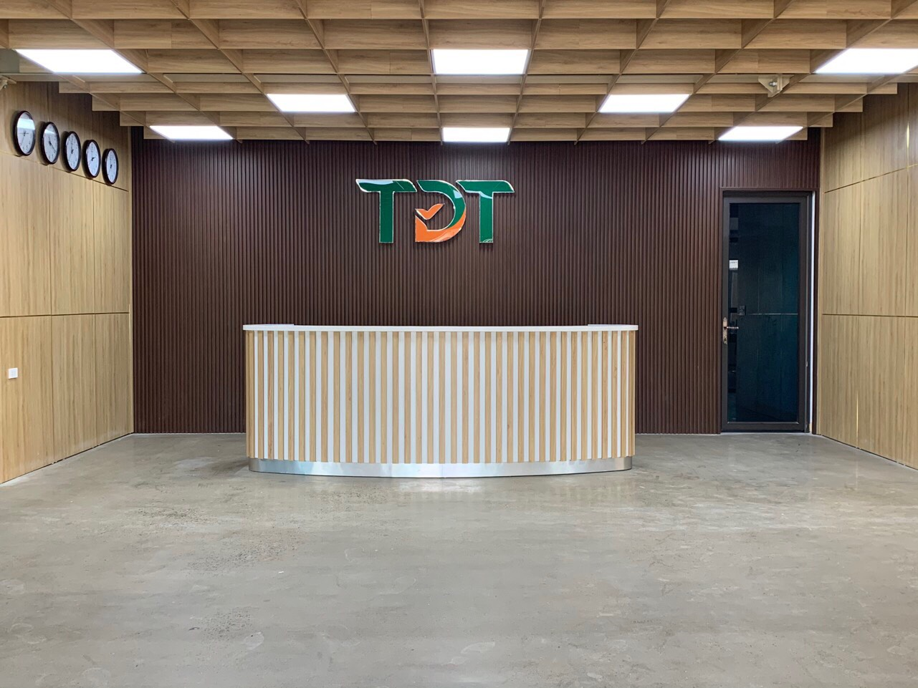
TDT COMPANY PROFILE
Thai Nguyen, Jun 2020

Slide 2
GENERAL INFORMATION
Name: TDT Investment and Development JSC
Established: 22th March, 2011
Core business: manufacturing and trading garment
Head office: Diem Thuy commune, Phu Binh district, Thai Nguyen province, Viet Nam
Telephone: (+84) 280 656 7898; Fax: (+84) 280 569.898
Plant area: 100,000 sqm
Total employees: 2,000 people
Contact: thangnv@tdtgroup.vn (VP) or thuha@tdtgroup.vn (Sales manager)
Website: www.tdtgroup.vn
Capacity for Jackets: 4,500,000 pieces / year (padding, down, fake down, coat…)
Capacity for bottoms: 9,000,000 pieces / year (chino, cargo, swim, skirt…)
50 km far from TDT to Noi Bai airport
130km far from TDT to Hai Phong port

Slide 3
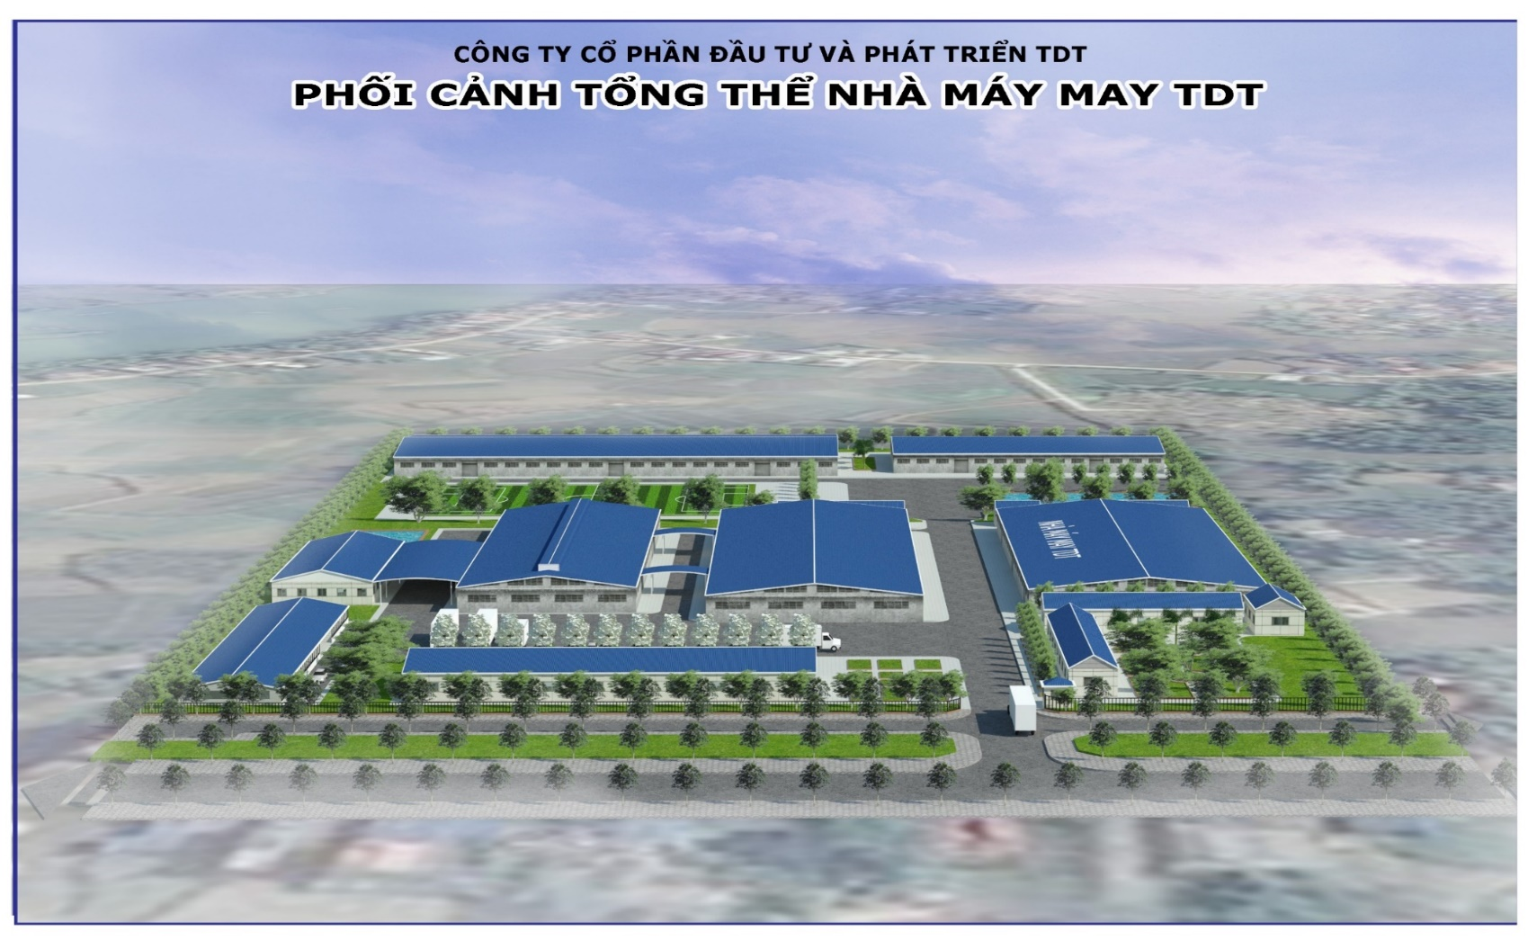
FACTORY LAYOUT (TDT DIEM THUY)

Slide 4
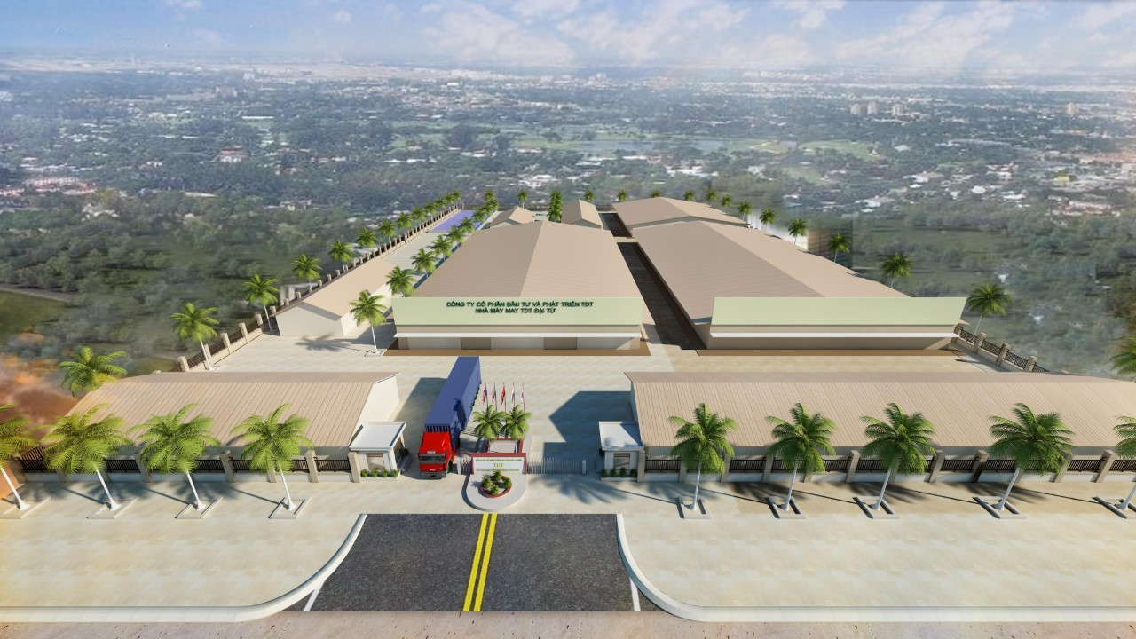
FACTORY LAYOUT (TDT DAI TU)

Slide 5
ORGANIZATION CHART
ANNUAL GENERAL MEETING
BOARD OF DIRECTOR
BOARD OF SUPERVISORD
BOARD OF MANAGEMENT
SALES DEPARTMENT
IMPOR-EXPORT DEPT
(FOB)
  OWN FACTORIES
HR DEPARTMENT
ACCOUNT DEPARTMENT
  SUB-CONTRACT FACOTRY
  (OUTSOURCING)
  DIEM THUY FACTORY
  DAI TU FACTORY
  THINH DUC FACTORY
  DESIGN TEAM
  TECHNICAL
  DEPARTMENT
  PLANNING
  DEPARTMENT
  QA/QC
  DEPARTMENT
  CUTTING SECTION
  SEWING LINES
  FINISHING SECTION
  MACHINE MAINTENANCE

Slide 6
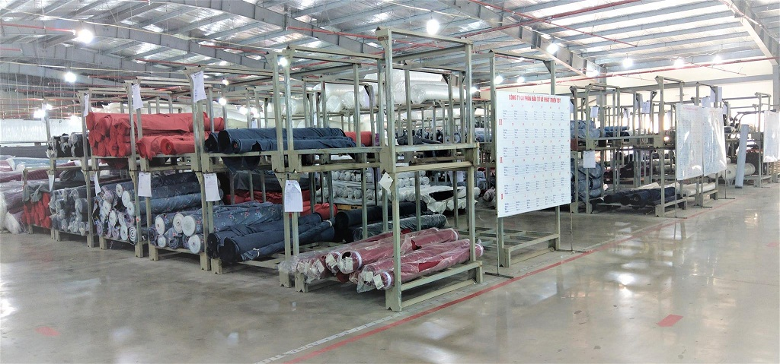
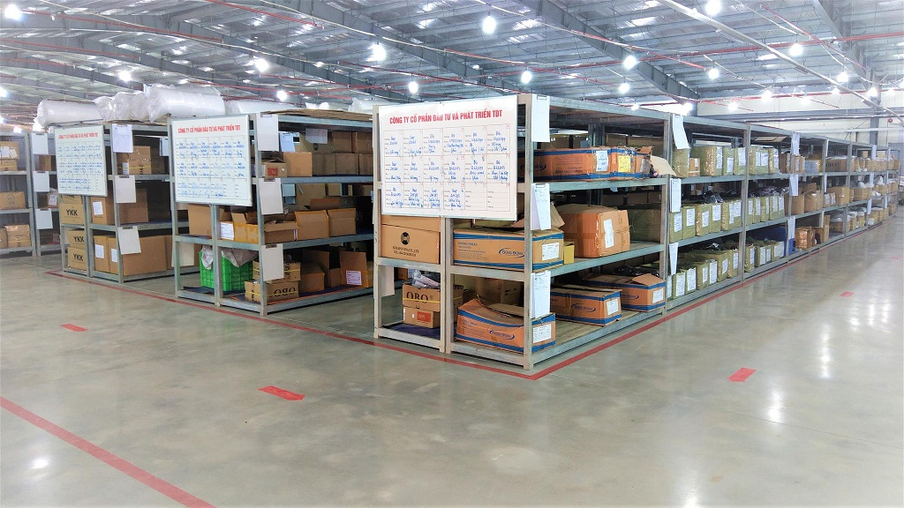
WAREHOUSE
Arranged according to 5S. Fire/smoke alarm systems. Sprinkler system. Camera installed all around.

Slide 7
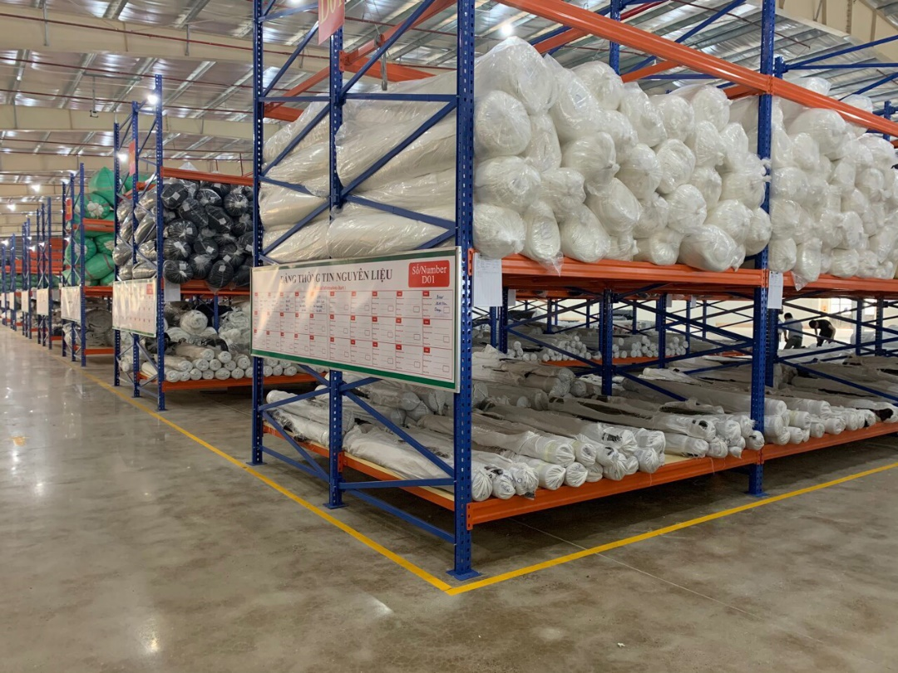
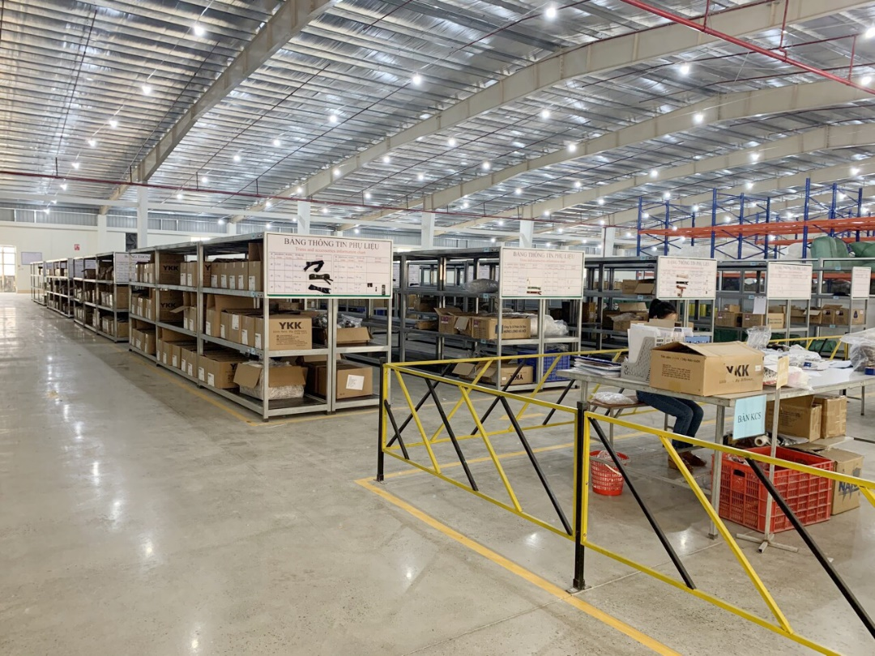
WAREHOUSE
Arranged according to 5S. Fire/smoke alarm systems. Sprinkler system. Camera installed all around.

Slide 8
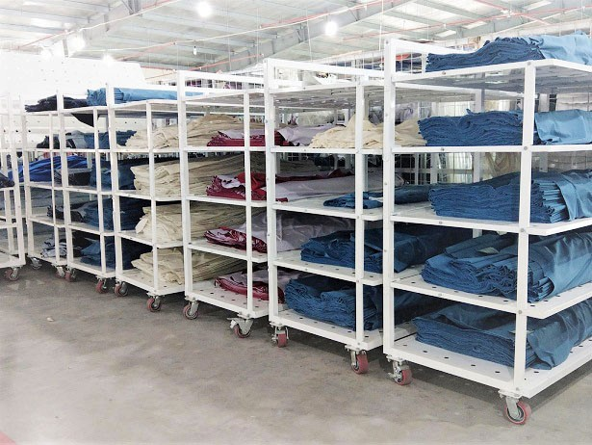
FABRIC RELAXAION

Slide 9
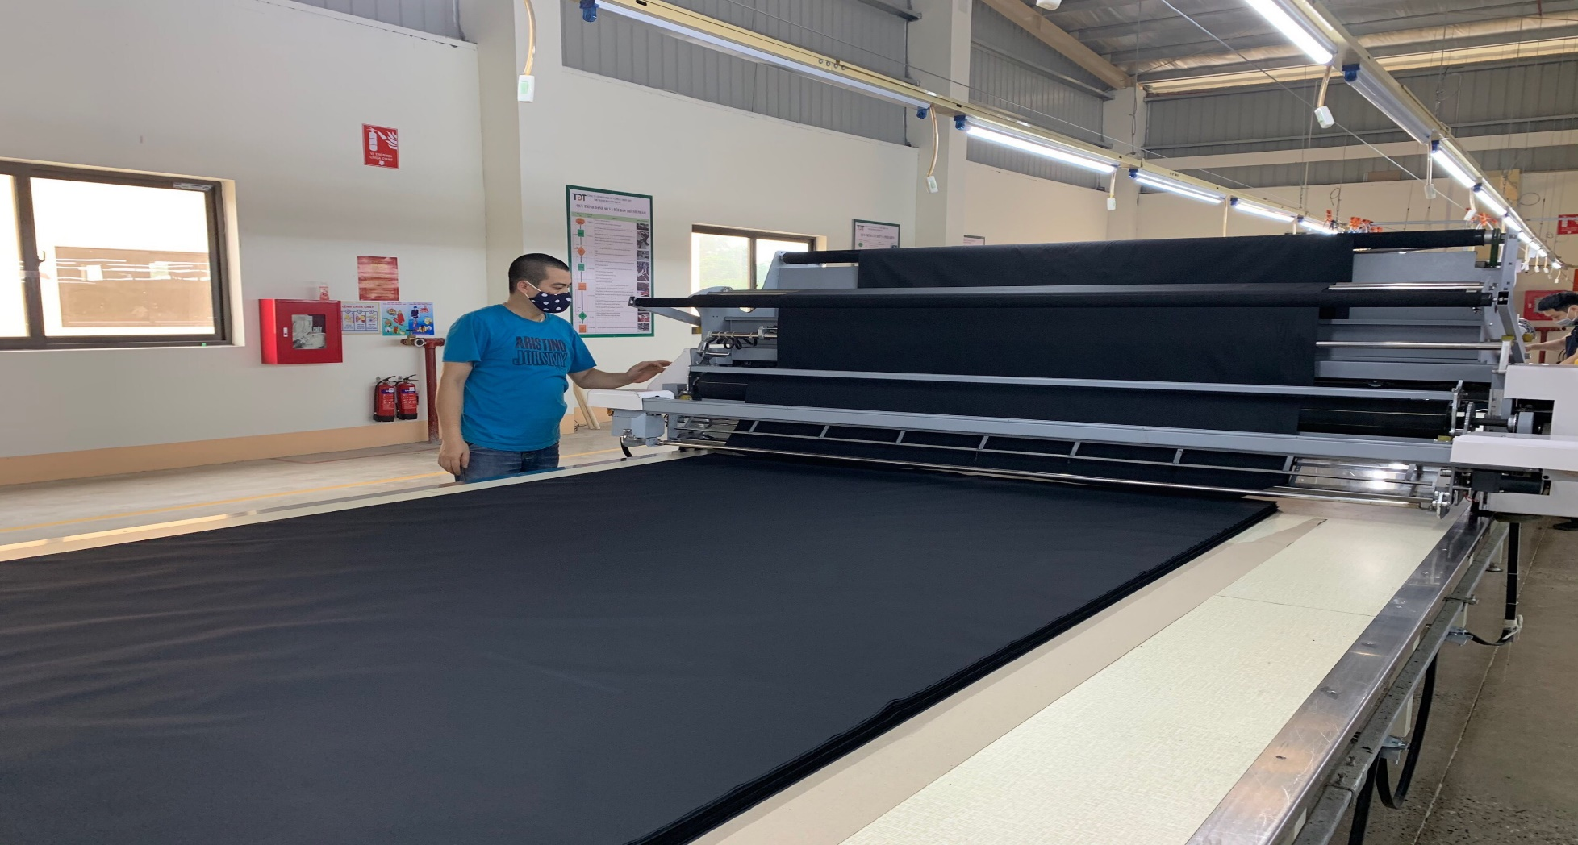
CUTTING SECTION

Slide 10
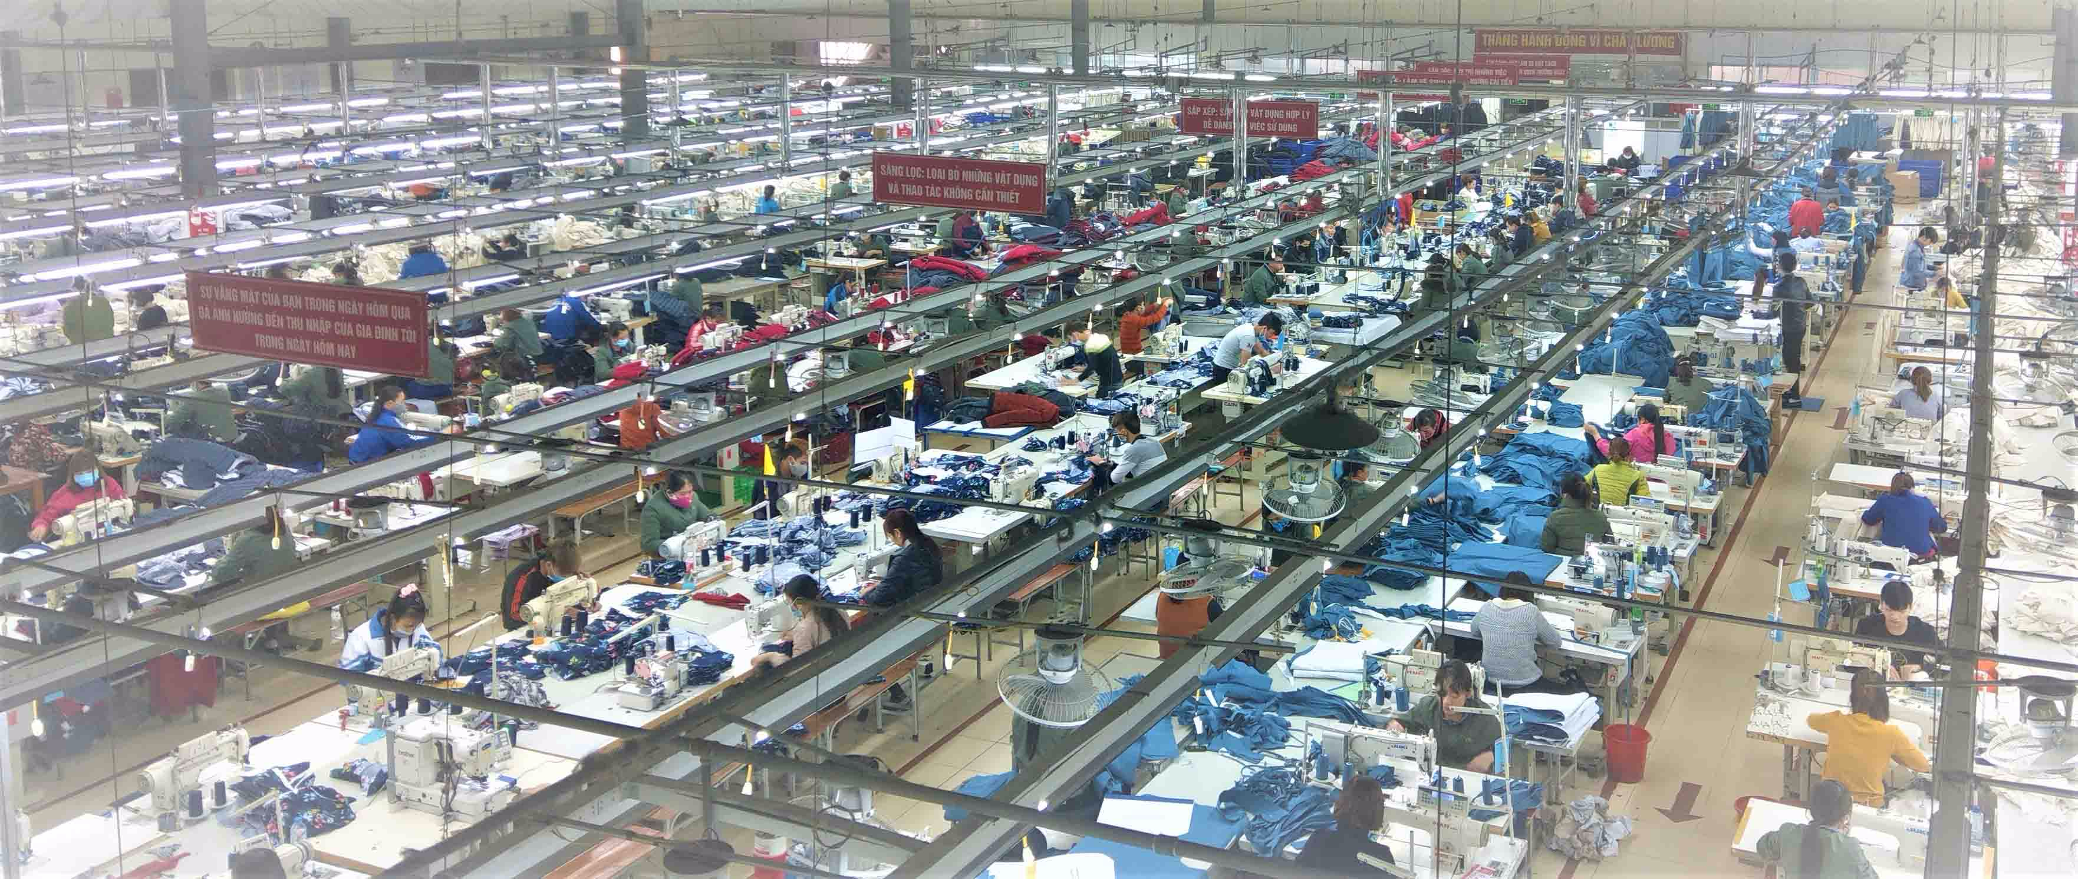
SEWING FLOOR

Slide 11
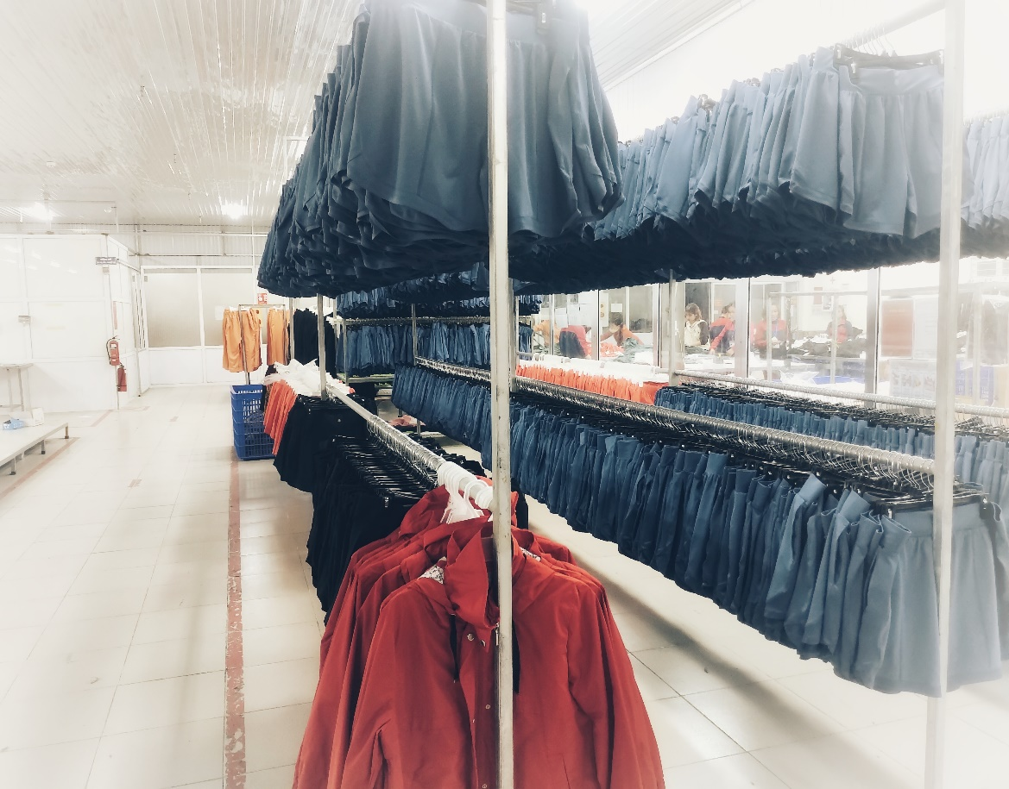
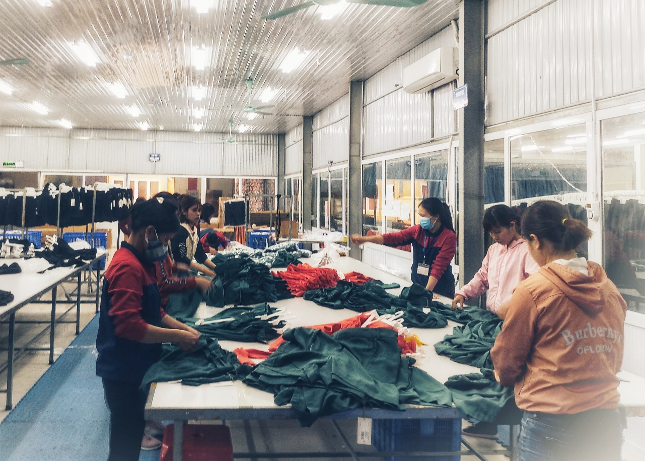
FINISHING SECTION

Slide 12
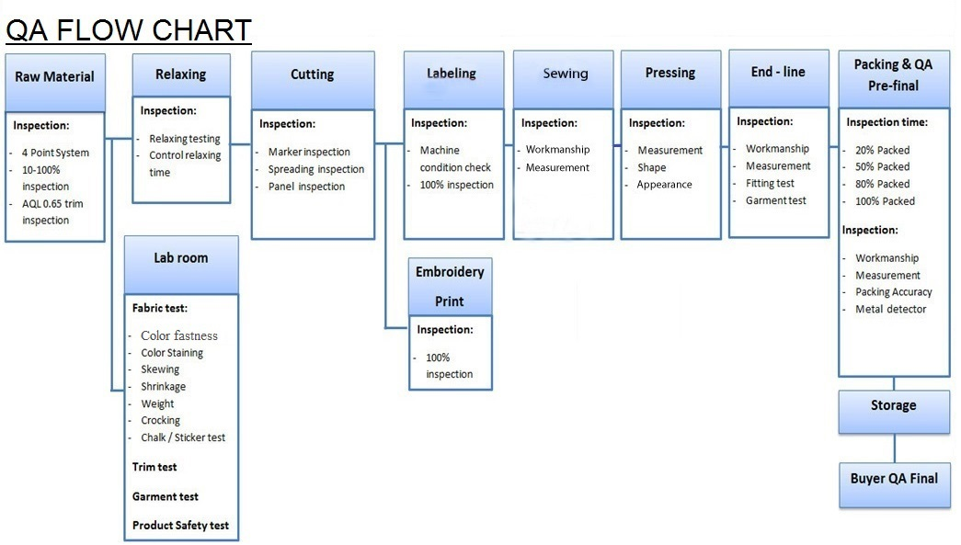
QUALITY CONTROL SYSTEM

Slide 13
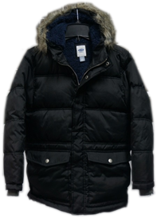
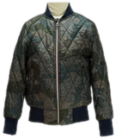
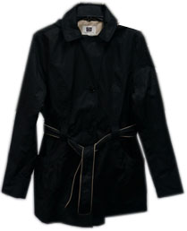
PRODUCT

Slide 14
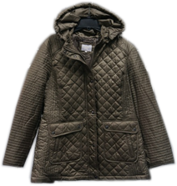
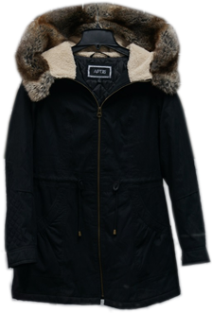
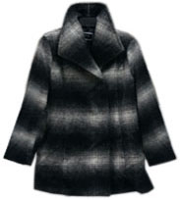
PRODUCT

Slide 15
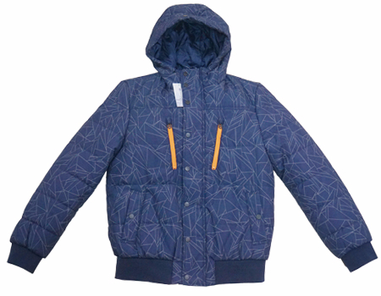
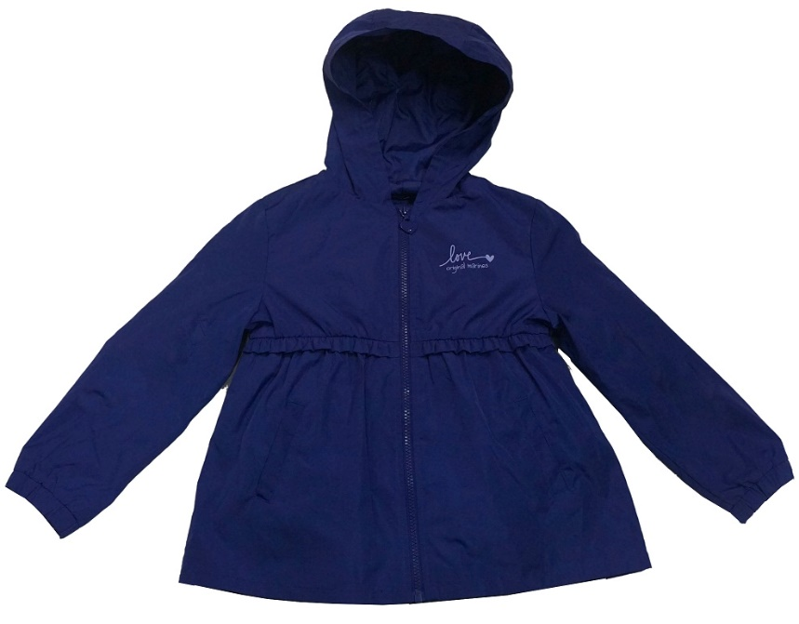
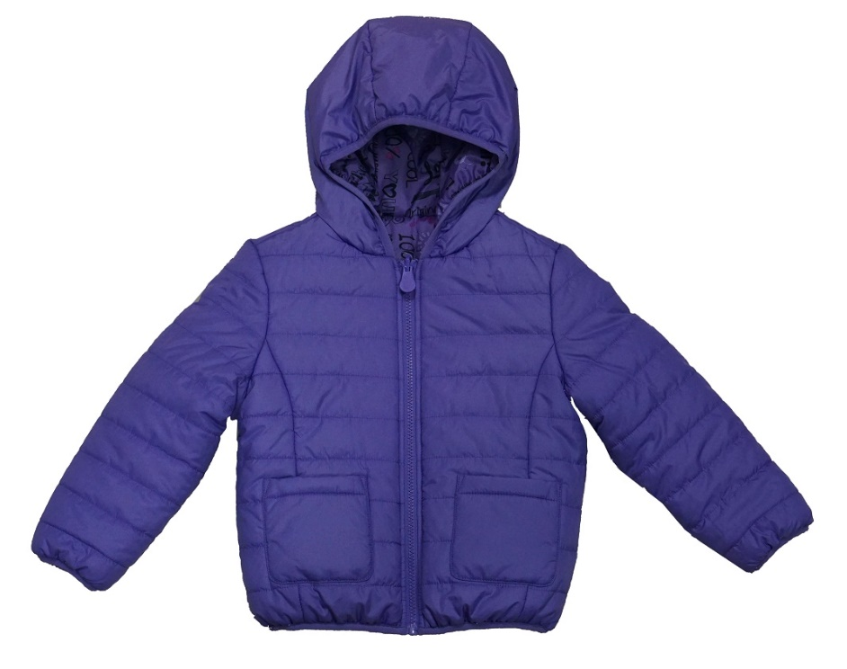
PRODUCT

Slide 16
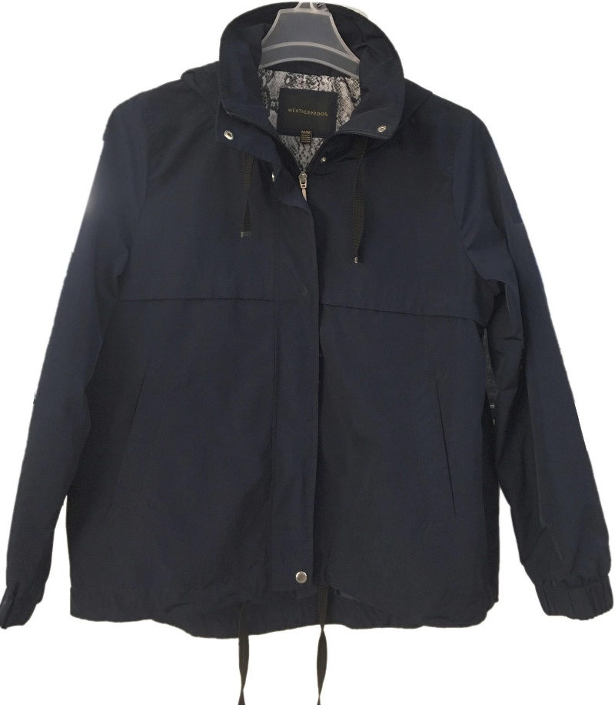
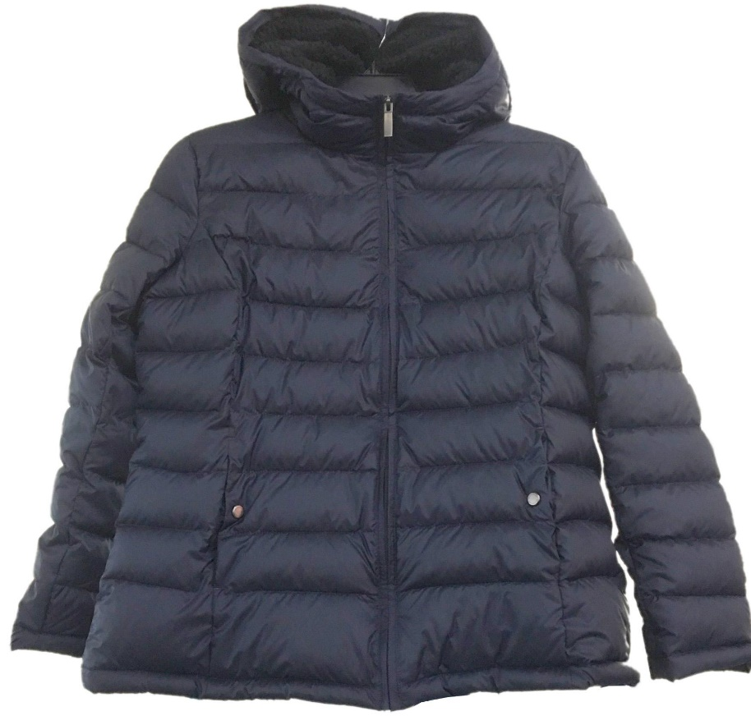
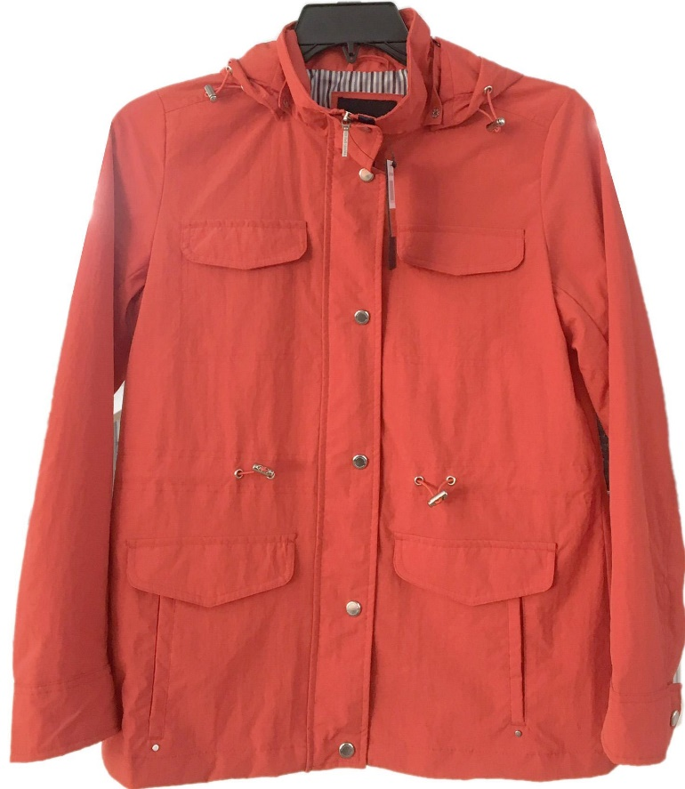
PRODUCT

Slide 17
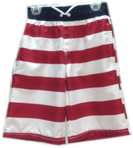
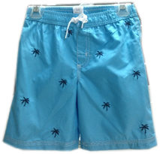
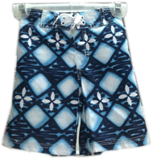
PRODUCT

Slide 18
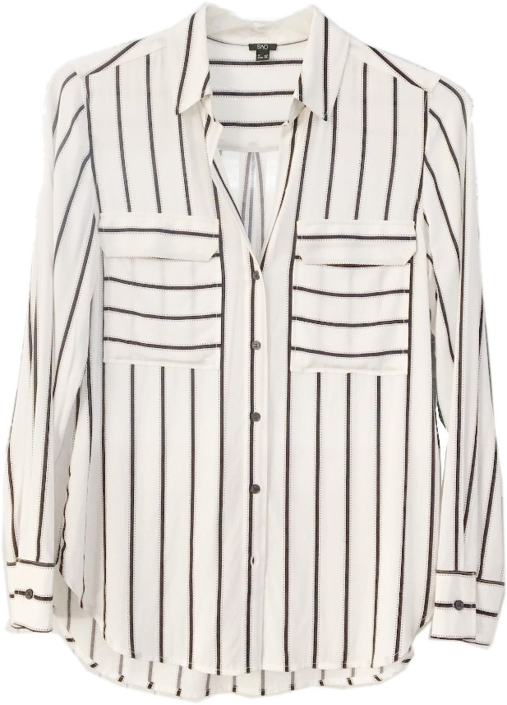
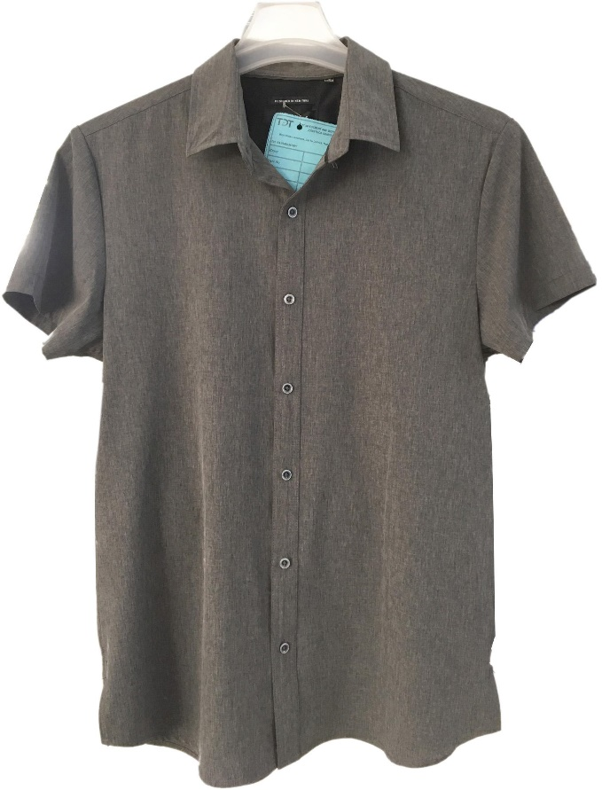
PRODUCT

Slide 19




BUYERS

Slide 20






BUYERS

Slide 21






BUYERS

Slide 22





BUYERS

Slide 23
CERTIFICATE (FACTORY AUDIT)
GAP/OLD NAVY
KOHL’S
ANF
VF
BETTER WORK
INDITEX
TARGET
SMETA
WRAP
WALMART
COSTCO
PVH

Slide 24
LEAD TIME AND MOQ
SAMPLE LEAD TIME: 48-72 HOURS
PRODUCTION LEAD TIME FOR CMPT ORDER: 30-45 DAYS
PRODUCTION LEAD TIME FOR FOB ORDER:90-135 DAYS
MOQ FOR BOTTOMS ORDER: 5,000 PCS / STYLE
MOQ FOR JACKET ORDER: 2,000 PCS / STYLE

Slide 25
MARKET SHARE (2019)

Slide 26
TDT AIM
ALWAYS MEET BUYER’S QUALITY STANDARD
ON TIME DELIVERY
LONG-TERM COPERATION WITH OUR PARTNERS
SUSTAINABLE DEVELOPMENT

Slide 27


